Slide 1
Update from the
COST Association
to the Management Committee
Dr. Fatima Bouchama & Ms Tania Gonzalez Ovin
Science Officer & Administrative Officer- COST Association
COST MP1106 Athens Meeting (EL) 04-07th May 2016

Slide 2
The COST Association
Under H2020 :
new COST organization
new Budgets and exceptional measures imposed by EC (Grant Period alignment with SGA seasonality)
new Vademecum, new Guidelines
new COST Monitoring and Final Assessment
new COST Open Call

Slide 3
The COST Association
Resolution adopted by all the Representatives of the Governments of the 35 COST Member Countries on 6 September 2013, the ‘COST Association’ was established on 19 September 2013 with the aim of providing the legal entity for the implementation of COST activities
The COST Association is established as an International Non-Profit Association under Belgian law (AISBL).
The Committee of Senior Officials has decided in its 194th CSO meeting held on 12-13 May 2015 in Stockholm to include Montenegro as the 36th COST Member Country.

Slide 4
COST Association organisation and relation with other actors
Committee Senior Officials
Ministerial Conferences (every five years)
Constitution:
  2 representatives per COST Country
Responsibilities:
  the overall strategy and steering of COST
  deciding on the launching of individual Actions
  approving participation of institutes from countries which
are not COST countries
  approving the extension of Actions
Committee Senior Officials (General Assembly)
COST
Association
Executive Board
Scientific Committee
COST National Coordinators
COST Association Administration
COST Actions
See: http://www.cost.eu/about_cost/who
26

Slide 5
COST Association organisation and relation with other actors
Scientific Committee
Ministerial Conferences (every five years)
Constitution:
  36 high-level experts (1 per COST country)
Responsibilities:
  Selection of the proposals for COST Actions to be approved by the CSO
  Quality control of procedures for the evaluation of proposals, monitoring of COST Actions and any other scientific activities
  Impact assessment of the finished COST Actions
  Contribution to COST S&T strategy development.
Committee Senior Officials (General Assembly)
COST
Association
Executive Board
Scientific Committee
COST National Coordinators
COST Association Administration
COST Actions
See: http://www.cost.eu/about_cost/who
26

Slide 6
COST Budget in H2020
EUR 300 million for 7 years from two H2020 work programmes:
    Challenge 6 “Europe in a changing world – inclusive, innovative and reflective Societies”
    “Spreading Excellence and Widening Participation”
    Following the publication of the work program 2016-2017, COST suffers from a budget reduction due to the "Junker Plan".
    “Engaging for COST”: online petition
    http://www.cost.eu/petition-for-budget-stability

Slide 7
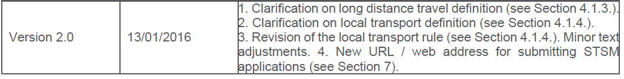
Updates documents
  See http://www.cost.eu/participate
New Vademecum released
http://www.cost.eu/download/COSTVademecum
New Guidelines for Action Management, Monitoring and Assessment
http://www.cost.eu/download/Guidelines_Action_management_monitoring_assessment
New Open Call process established
http://www.cost.eu/participate/open_call

Slide 8

COST Policies under H2020

Slide 9
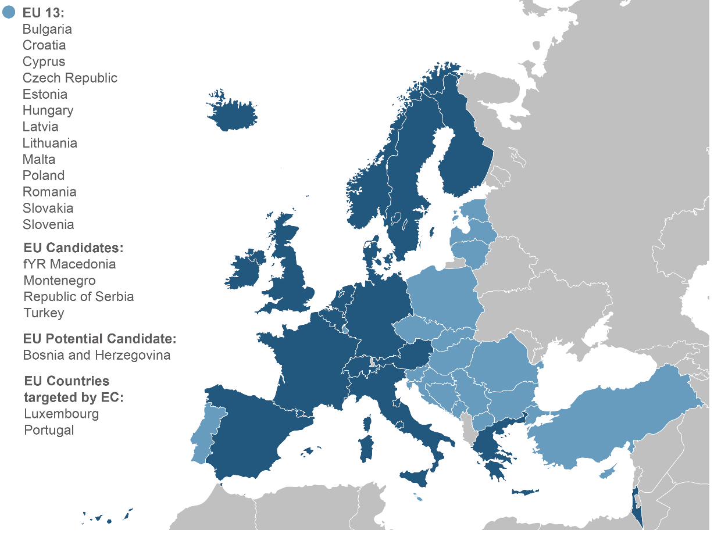
Inclusiveness Target Countries

Slide 10
Monitoring of Actions
Monitor running and assess ended Actions with regards to
  achievement of MoU objectives
  provision of MoU deliverables
  contribution to the COST Mission
  implementation of COST policies

Slide 11
Monitoring and Final Assessment (MFA) of Actions
First Progress and Monitoring Report – 12 months (PR1)
Second Progress and Monitoring Report – 24 months (PR2)
Final Achievement Report – 48 months (end of Action)(FAR)
http://www.cost.eu/download/Final_Achievement_Report_MC_Chair
Scientific Committee
Action Rapporteur (independent external expert)
reports remotely

Slide 12
MP1106: Monitoring
  FAR at 48th month
  to be submitted on the 01/07/2016
  Action Rapporteur for PR1 :
  Under progress

Slide 13
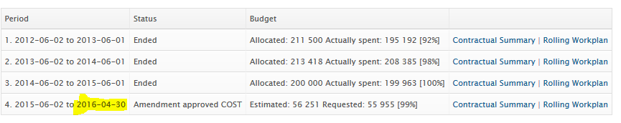
MP1106- Grant Periods Alignment
Under H2020: exceptional measures implemented, alignment of Action Grant Agreements (AGAs) with the seasonality of the Specific Grants Agreements (SGA) the COST Association is signing yearly with EC.
SGA2 : 01/05/2015 – 30/04/2016
GP4 : 02/06/2015 – 10/05/2016
Amendment to anticipate the end date of the GP

Slide 14
MP1106- Last GP Budget
Last Grand Period
  01/05/2016 to 10/05/2016
  Total allocated Budget: up to 100 000 Euros (incl. FSAC)
  Drafting of WBP in e-COST once the e-cost notification is received (after amendment finalized)
  Final Meeting: e-cost invitations to be sent once last GP is active
  Financial reporting deadline

Slide 15
COST Open Call
Webpage: www.cost.eu/opencall
Rules & procedure for the submission, evaluation, selection and approval of COST Action proposals (COST 133/14 B.1.)
COST Open Call Submission, Evaluation, Selection and Approval (SESA) guidelines
COST Action proposal template (Technical Annex.docx)
Stay tuned for COST updates:
http://www.cost.eu/participate/open_call

Slide 16
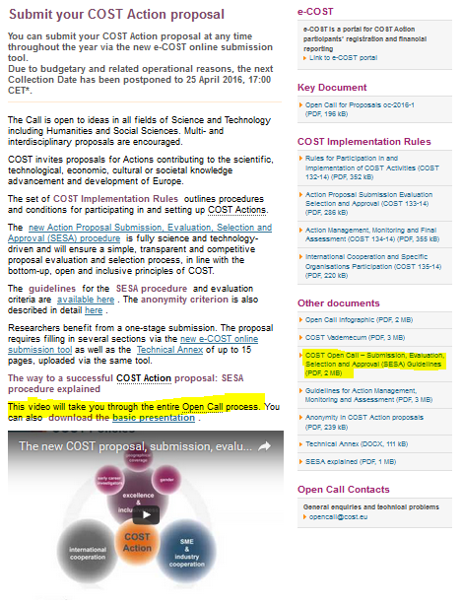
COST Open Call
http://www.cost.eu/participate/open_call
Collection dates
Spring and Autumn collection dates
Last collection date:
25th April 2016, 17:00 (CET)
Foreseen next collection date:
01st December 2016, 12:00 (CET)

Slide 17
COST Open Call procedure
Step 1: Proposal Evaluation by Independent External Expert
Step 2: Revision and Quality check by ad-hoc Review Panels
Step 3: Proposal Selection by COST Scientific Committee
Proposal Approval by the Committee of Senior Officials (CSO)

Slide 18
Eligibility Criteria
Represent a network of proposers from at least 5 COST Member Countries or Cooperating State with researchers, engineers or scholars having a registered e-COST profile
Be coordinated by a Main Proposer in a COST Member Country or Cooperating State
Be anonymous, hence not contain any reference to the names and/or institutions of the participants in the network of proposers
Address science and technology challenges destined only for peaceful purposes
Respect word or page limits as described in the SESA Guidelines
English, the working language of the COST Association
Not be identical with another submitted proposal

Slide 19
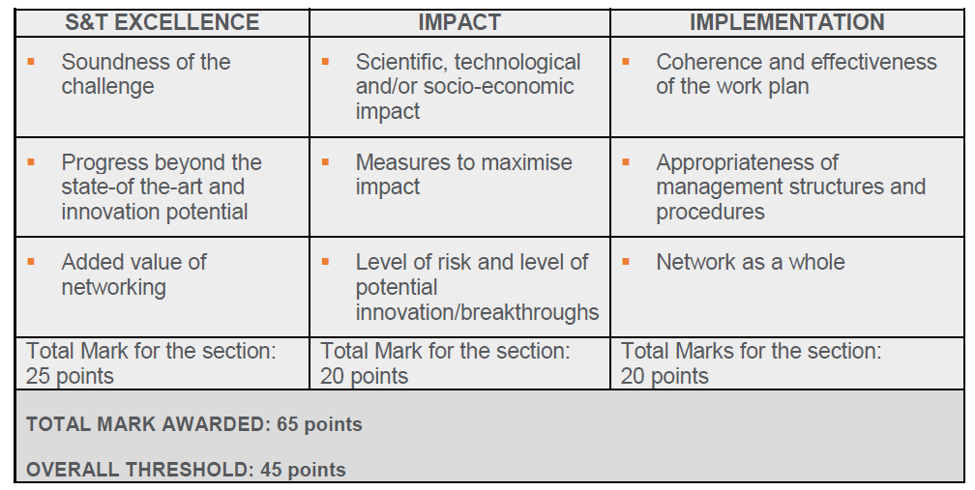
Evaluation Criteria

Slide 20
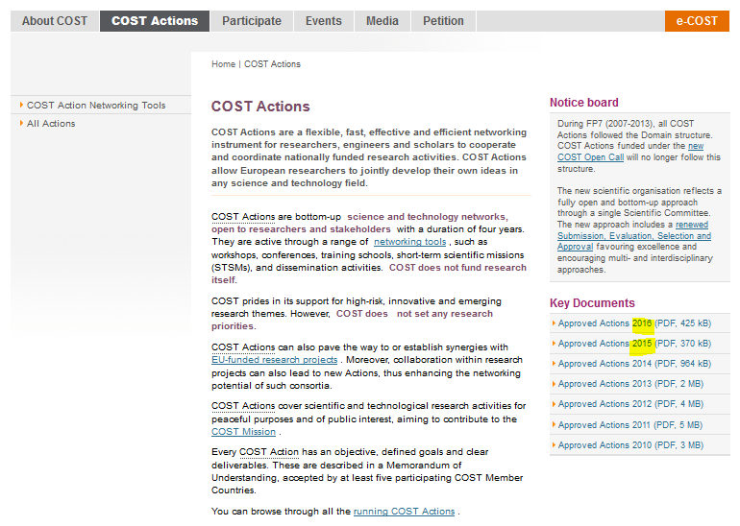
New Actions oc-2015-1&2
http://www.cost.eu/COST_Actions

Slide 21
Become a COST Expert!
As a COST Expert, you will have the opportunity to:
contribute to the evaluation of COST Open Call proposals;
participate in the assessment of Action results and outcomes;
take part in the assessment of COST strategic activities
New experts can express their interest via the COST Expert online registration form (www.cost.eu/experts)
An updated Curriculum Vitae with a list of publications is required to demonstrate competence in specific areas of expertise.
More on COST Experts: www.cost.eu/participate/experts

Slide 22
Finance and Administration

Slide 23
Challenges
Transition from ESF to COST Association – 30 November 2014
Vademecum updated and released 2x
Update and implemementaion of new functionality in e-COST
  Strong Authentication
  Assignation of the different position
  WBP submission process in e-COST
  AGA / Amendment process
  Electronic signature

Slide 24
Administrative and Financial aspect: Consequences:
  EU Constraints: to align all GP to all Action to start the period: from 01st May till 30th April
Amendment to shorten the initial Grant Period raised some IT issues
  Carry-Over must be apply and no possibility to generate a new AGA with 0 € budget in e-COST
  Amendment delay: Released on 22/04/2016

Slide 25
Amendment and Grant Agreement Workflow
  E-COST closed for the period from 01/05/2016 till 10/05/2016 upon signature of the new AGA.
    Signature of the Amendment
    Grant Period create in e-COST
    Submission WBP by the Chair
    Science Officer Approval
    MC Approval
    Release of the AGA to the LR
    Signature of the AGA
    Official invitation will be sent

Slide 26
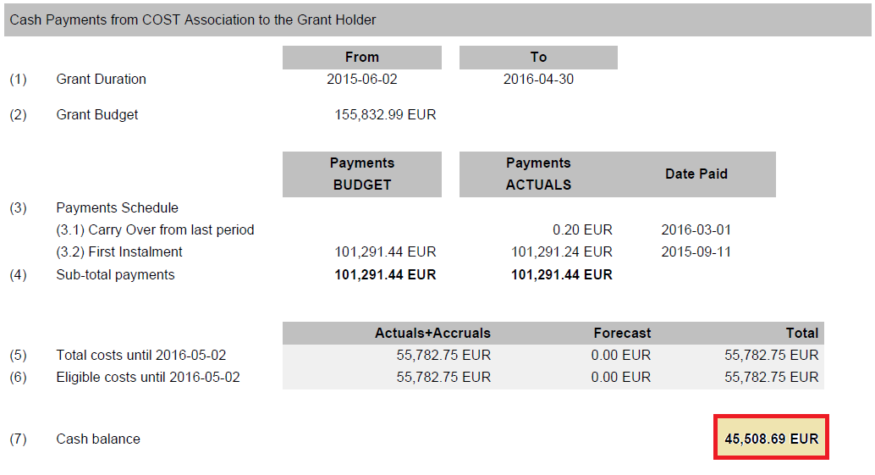
Financial Situation – Budget Impact
Initial Budget: 155 832,99 € (final event included)
Amended Budget: 55 955,12 €
  The amount of the amended budget has been calculated based on the financial report issued end March taking into account the accruals at that moment.

Slide 27
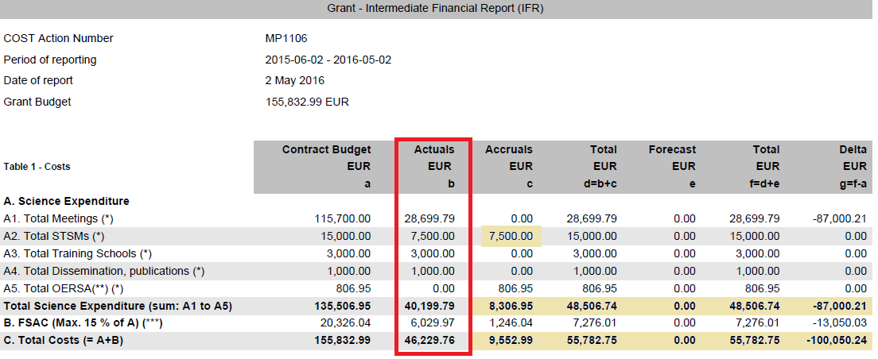
Activities & Expenditures
GP till 30/04/2016
2 Meetings
10 STSM’s
1 Training School
Dissemination: Website

Slide 28
Reminder
YFR must be submitted by 29/06/2016 latest
Deadlines:
    Participants: Submission of TRR within 30 days after the end date of the meeting
    Grant Holder:
    Payments to be processed 60 days after the end date of the meeting
  Sign the attendance list

Slide 29






Thank you!
COST – European Cooperation in Science and Technology
Avenue Louise 149
1050 Brussels, Belgium
T: +32 (0)2 533 3800
F: +32 (0)2 533 3890
www.cost.eu

Slide 30
Step1: External Remote Evaluation
3 Independent External Experts
  COST Expert data base
  CV + expertise
  Validated by the COST SC
Remote peer-review evaluation
Remote consensus shall be sought between the Independent External Experts
The consensus shall not be imposed; independent External Experts may maintain their views on the proposal
Eventual differences in opinion of the experts resulting in a non-consensual decision will be handled and arbitrated by the Review Panel

Slide 31
Step 2: Revision and Quality check
By Review Panels
  Active researchers, engineers or scholars
  Appointed by COST National Coordinators
  Ad hoc Review Panels set by the COST Association
  Validated by the COST Scientific Committee
Reviewing and validating all the Consensus Reports and marks
Resolving the differences in opinions among the Independent External Experts
After validation of consensus reports and marks, rank the proposals above the threshold
For the proposals above the threshold, identify those that indicate emerging issues or potentially important future developments

Slide 32
Step 3 : Selection
By the COST Scientific Committee
  36 high-level experts representing the 35 COST Member Countries and 1 Cooperating state (Israel)
  Appointed by and reports to CSO
Shall select among the ranked list of proposals received from the Review Panels by discriminating among proposals with the same marks, taking into account the COST mission and policies
  Focus on Excellence and Inclusiveness
Balanced COST Action portfolio, by ensuring the coverage of all S&T fields
Shall submit the final ranked list of selected proposals to the CSO for approval

