Slide 1
The WG 3 on „Diagnostics“ worked pretty efficient and the output
of the involved groups is enormous: 72 publications in 2015/2016
N. Denkov, S. Tcholakova, I. Lesov, D. Cholakova, S. K. Smoukov. Self-Shaping of Oil Droplets via the Formation of Intermediate Rotator Phases upon Cooling, Nature 528 (2015) 392–395
N. Mucic, A. Javadi, J. Krägel, M. Karbaschi, E.V. Aksenenko , V.B. Fainerman and R. Miller, Thermodynamic characterization of ionic surfactant adsorption at the water/hexane interface, in “Colloid Process Engineering”, M.Kind, W.Peukert, H.Rehage and H.P.Schuchmann (Eds.), Springer Verlag, 2015, ISBN: 978-3-319-15129-8, pp. 309-321.
M. Lotfi, A. Javadi, S.V. Lylyk, D. Bastani, V.B. Fainerman and R. Miller, Adsorption of proteins at the solution/air interface influenced by added non-ionic surfactants at very low concentrations for both components. 1. Dodecyl dimethyl phospine oxide, Colloids Surfaces A, 475 (2015) 62–68.
A. Dan, G. Gochev, R. Miller, Tensiometry and Dilational Rheology of Mixed β-Lactoglobulin/Ionic Surfactant Adsorption Layers at Water/Air and Water/Hexane Interfaces, J. Colloid Interface Sci., 449 (2015) 383-391
R. Miller, E.V. Aksenenko, Igor I. Zinkovych and V.B. Fainerman, Adsorption of proteins at the aqueous solution/alkane interface: co-adsorption of protein and alkane, Adv. Colloid Interface Sci., 222 (2015) 509-516.
M.P. Krafft, V.B. Fainerman and R. Miller Modeling of the effect of fluorocarbon gases on the properties of phospholipid monolayers and the adsorption dynamics of their aqueous solutions or dispersions, Colloid Polymer Sci., 293 (2015) 3091–3097
V.B. Fainerman, E.V. Aksenenko, S.V. Lylyk, M. Lotfi and R. Miller, Adsorption of proteins at the solution/air interface influenced by added non-ionic surfactants at very low concentrations for both components. 3. Dilational surface rheology, J. Phys. Chem. B, 119 (2015) 3768–3775.
V.D. Mys, V.B. Fainerman, A.V. Makievski, M.P. Krafft and R. Miller, Dynamic surface tension of С₁₀ЕО₈ at the aqueous solution/hexane vapor interface as measured by bubble pressure tensiometry, Colloids Surfaces A, 483 (2015) 137-141.
S. Bučko, J. Katona, Lj. Popović, Ž. Vaštag, L. Petrović and M. Vučinić–Vasić, Investigation on solubility, interfacial and emulsifying properties of pumpkin (Cucurbita pepo) seed protein isolate, LWT Food Sci Technol, 64 (2015) 609-615.
J. Katona, A. Tomšik, S. Bučko and L. Petrović, Influence of ionic strength on the rheological properties of hydroxypropylmethyl cellulose–sodium dodecylsulfate mixtures, Acta Periodica Technologica, 46 (2015) 229–237.
E. Guzmán, E. Santini, M. Ferrari, L. Liggieri, F. Ravera, Interfacial Properties of Mixed DPPC–Hydrophobic Fumed Silica Nanoparticle Layers. J. Phys. Chem. C, 119 (2015), pp 21024–21034. DOI: 10.1021/acs.jpcc.5b07258.
E. Guzmán, E. Santini, M. Ferrari, L. Liggieri, and F. Ravera, Effect of silica nanoparticles on the interfacial properties of a canonical lipid mixture. Coll. & Surf. B: Biointerfaces, 136 (2015) pp. 971–980. DOI:10.1016/j.colsurfb.2015.11.001
E. Guzmán, E. Santini, D. Zabiegaj, M. Ferrari, L. Liggieri, F. Ravera, Interaction of Carbon Black Particles and Dipalmitoylphosphatidylcholine at the Water/Air Interface: Thermodynamics and Rheology. J. Phys. Chem. C, 119 (2015), pp. 26937-26947
D. Kosior, J. Zawala, A. Niecikowska, K. Malysa, “Influence of non-ionic and ionic surfactants on kinetics of the bubble attachment to hydrophilic and hydrophobic solids”, Colloids Surfaces A:, 470 (2015) 333–341.
J. Zawala, D. Kosior, K. Malysa, “Formation and influence of the dynamic adsorption layer on kinetics of the rising bubble collisions with solution/gas and solution/solid interfaces”, Advances Coll. Interface Sci., 222 (2015) 768-778.
S.S. Dukhin, V.I. Kovalchuk, G.G. Gochev, M. Lotfi, M. Krzan, K. Malysa, R. Miller, “Dynamics of Rear Stagnant Cap Formation at the Surface of Spherical Bubbles Rising in Surfactant Solutions at large Reynolds numbers under conditions of Small Marangoni Number and Slow Sorption Kinetics”, Advances Coll. Interface Sci., 222 (2015) 260–274.
L. Champougny, B. Scheid, F. Restagno, J. Vermant, E. Rio, “Surfactant-induced rigidity of interfaces: a unified approach to free and dip-coated films”, Soft Matter, 11, 2758, (2015).
W. Drenckhan and S. Hutzler “The structure and energy of liquid foams” Adv. Colloid Interface Sci., 224 (2015) 1-16
Kramek-Romanowska K., Odziomek M., Sosnowski T.R. Dynamic tensiometry studies on interactions of novel therapeutic inhalable powders with model pulmonary surfactant at the air-water interface. Coll. Surf. A: Physicochem. Eng. Aspects 480 (2015) 149-158.
Odziomek M., Sosnowski T.R., Gradoń L. The influence of Functional Carrier Particles (FCPs) on the molecular transport rate through the reconstructed bronchial mucus - in vitro studies. Transport in Porous Media 106 (2015) 439-454.
Sosnowski T.R. Nanosized and nanostructured particles in pulmonary drug delivery. J. Nanosci. Nanotechnol. 15 (2015) 3476-3487.
Broniarz-Press L., Sosnowski T.R., Matuszak M., Ochowiak M., Jabłczyńska K. The effect of shear and extensional viscosities on atomization of Newtonian and non-Newtonian fluids in ultrasonic inhaler. Int. J. Pharmaceutics 485 (2015) 41–49.
A. Perazzo, V. Preziosi, S. Guido, Phase inversion emulsification: Current understanding and applications, Advances in Colloid and Interface Science 222 (2015) 581–599. Http://dx.doi.org/10.1016/j.cis.2015.01.001
R. D'Apolito, F. Taraballi, S. Minardi, X. Liu, S. Caserta, A. Cevenini, E. Tasciotti, G. Tomaiuolo, S. Guido, Microfluidic interactions between red blood cells and drug carriers by image analysis techniques, Medical Engineering & Physics 38, 1, pp. 17-23, DOI: http://dx.doi.org/10.1016/j.medengphy.2015.10.005.
A. Perazzo, G. Tomaiuolo, L. Sicignano, G. Toscano, R. E. Meadows, S. P. Nolan, S. Guido, A microfluidic approach for flexible and efficient operation of a cross-coupling reactive flow. RSC Adv., 2015, 5, 63786 DOI: 10.1039/c5ra10971j
R. D'Apolito, G. Tomaiuolo, F. Taraballi, S. Minardi, D. Kirui, X. Liu, A. Cevenini, R. Palomba, M. Ferrari, F. Salvatore, E. Tasciotti, S. Guido, Red blood cells affect the margination of microparticles in synthetic microcapillaries and intravital microcirculation as a function of their size and shape, Journal of Controlled Release 217 (2015) 263–272, http://dx.doi.org/10.1016/j.jconrel.2015.09.013
G. Tomaiuolo, A. Carciati, S. Caserta, S. Guido, Blood linear viscoelasticity by small amplitude oscillatory flow, Rheol Acta DOI 10.1007/s00397-015-0894-3
G. Tomaiuolo, L. Lanotte, R. D’Apolito, A. Cassinese, S. Guido, Microconfined flow behavior of red blood cells, Medical Engineering and Physics 2015. Http://dx.doi.org/10.1016/j.medengphy.2015.05.007
Todorov R. 2015 “Thin liquid films in biomedical studies” Curr Opin Colloid Interface Sci 20: 130-138.
Terziyski I., Todorov R., Exerowa D. 2015 “Investigation of microscopic foam films from Tween 80” Nanoscience & Nanotechnology: Nanostructured Materials Application and Innovation Transfer 15: 40-42.
V. Milkova, Ts. Radeva, Influence of charge density and calcium salt on stiffness of polysaccharides multilayer film, Colloids Surf. A: Physicochem. Eng. Aspects 481 (2015) 13-19.
K. Kamburova, N. Boshkova, N. Boshkov, Ts. Radeva, Design of polymeric core-shell nanocontainers impregnated with benzotriazole for active corrosion protection of galvanized steel, Colloids Surf. A: Physicochem. Eng. Aspects 499 (2016) 24-30.
P. Posocco, A. Perazzo, V. Preziosi, E. Laurini, S. Pricl, S. Guido, Interfacial tension of oil/water emulsions with mixed non-ionic surfactants: comparison between experiments and molecular simulations, RSC Adv., 2016, 6, 4723 DOI: 10.1039/c5ra24262b
V. Preziosi, G. Tomaiuolo, M. Fenizia, S. Caserta, S. Guido, Confined tube flow of low viscosity emulsions: Effect of matrix elasticity, Journal of Rheology, 60, 419 (2016), DOI: 10.1122/1.4943987.
R. Liuzzi, A. Carciati, S. Guido, S. Caserta, Transport Efficiency in Transdermal Drug Delivery. What is the Role of Fluid Microstructure? Colloids and Surfaces B-Biointerfaces 139, pp. 294-305, 2016 DOI: 10.1016/j.colsurfb.2015.11.064.
D. Donnarumma, G. Tomaiuolo, S. Caserta, Y. Gizaw, S. Guido., Water Evaporation in Porous Media by Dynamic Vapor Sorption, Colloids and Surfaces A: Physicochemical and Engineering Aspects, 480, 2015. DOI: 10.1016/j.colsurfa.2014.11.011
D. Platikanov, G. Gochev and R. Miller, Chronicles of foam films and bubbles, Adv. Colloid Interface Sci., (2016); doi: 10.1016/j.cis.2015.08.009.
S.S. Dukhin, M. Lotfi, V.I. Kovalchuk, D. Bastani and R. Miller, Dynamics of Rear Stagnant Cap Formation at the Surface of Rising Bubbles in Surfactant Solutions at Large Reynolds and Marangoni Numbers and for Slow Sorption Kinetics, Colloids Surfaces A, 492 (2016) 127–137.
S. Bucko, J. Katona, Lj. Popovic, L. Petrovic and J. Milinkovic (2016) Influence of enzymatic hydrolysis on solubility, interfacial and emulsifying properties of pumpkin (Cucurbita pepo) seed protein isolate, Food Hydrocoll, 60 (2016) 271–278.
S. Bučko, J. Katona, Lj. Popović, Ž. Vaštag and L. Petrović, Functional properties of pumpkin (Cucurbita pepo) seed protein isolate and hydrolysate, J. Serb. Chem. Soc. 81 (2016) 35–46.
N. Moradi, Y. Zakrevskyy, S. Santer, A. Javadi, E.V. Aksenenko, V.B. Fainerman and R. Miller, Surface tension and dilation rheology of DNA solutions in mixtures with cationic surfactant Azo-TAB, Colloids Surfaces A, DOI 10.1016/j.colsurfa.2016.04.021
R. Miller, E.V. Aksenenko, V.I. Kovalchuk, Y.I. Tarasevich, D.V. Trukhin and V.B. Fainerman, Mixed Protein/Hexane Adsorption Layers Formed at the Surface of Protein Solution Drops Surrounded by Hexane Vapor, Advanced Materials Interfaces, accepted
E. Guzmán, S. Llamas, A. Maestro, L. Fernández-Peña, A. Akanno, R. Miller, F. Ortega and R.G. Rubio, Polymer – Surfactant Systems in Bulk and at Fluid Interfaces, Adv. Colloid Interface Sci., doi:10.1016/j.cis.2015.11.001.
N. Pagureva, S. Tcholakova, K. Golemanov, N. Denkov, E. Pelan, S. D. Stoyanov, Surface Properties of Adsorption Layers Formed from Triterpenoid and Steroid Saponins, Colloids and Surfaces A, 491 (2016) 18–28.
Joo Y. Won, Vamseekrishna Ulaganathan, Ayim Tleuova, Talmira Kairaliyeva, Altynay A. Sharipova, Xiu W. Hu, Mohsen Karbaschi, Georgi Gochev, Aliyar Javadi, Mohammad Taeibi Rahni, Alexander V. Makievski, Jürgen Krägel, Saule B. Aidarova and Reinhard Miller, Profile Analysis Tensiometry for Studies of Liquid Interfacial Dynamics, in “Laser Optofluidics in Fighting Multiple Drug Resistance”, M.L. Pascu (Ed.), BENTHAM Publ., 2016
I.T. Horvath, P. Colinet, M.R. Vetrano, Assessment of the light extinction spectroscopy technique for submicron particle characterization, Powder Technology 291 (2016) 375–382
N.M. Kovalchuk, O.K. Matar, R.V. Craster, R.Miller and V.M. Starov, Effect of adsorption kinetics on the rate of surfactant-enhanced spreading, Soft Matter, 12 (2016) 1009-1013
J. Zawala, D. Kosior, T. Dabros, K. Malysa, "Influence of bubble surface fluidity on collision kinetics and attachment to hydrophobic solids", Colloids Surfaces A, (2016) doi:10.1016/j.colsurfa.2015.12.023
J. Zawala, "Energy balance in viscous liquid containing a bubble” rise due to buoyancy", Can. J. Chem. Eng. 94 (2016) 586 - 595
J. Zawala, D, Kosior "Dynamics of dewetting and bubble attachment to rough hydrophobic surfaces - measurements and modelling", Miner. Eng. 85 (2016) 112 - 122
Kondej D., Sosnowski T.R. Effect of clay nanoparticles on model lung surfactant: a potential marker of hazard from nanoaerosol inhalation. Env. Sci. Pollut. Res. 23 (2016) 4660-4669.
Sosnowski T.R. Selected engineering and physicochemical aspects of systemic drug delivery by inhalation. Current Pharm. Design – accepted, DOI: 10.2174/1381612822666160128145644
Sosnowski T.R., Kramek-Romanowska K. (2016). Predicted deposition of e-cigarette aerosol in the human lungs J. Aerosol Med. Pulm. Drug Del. – accepted, DOI:10.1089/jamp.2015.1268
I. T. Horváth, P. Colinet, M. R. Vetrano, Measuring contact angles of small spherical particles at planar fluid interfaces by Light Extinction, submitted to Applied Physics Letters, 2016, submitted
A. Hutin, J.F. Argillier and D. Langevin “Influence of pH on oil-water interfacial tension and mass transfer for asphaltenes model oils. Comparison with crude oil behaviour”, OGST, submitted.
J. Zawala, A. Wiertel, A. Niecikowska, K. Malysa "Influence of external vibrations on bubble coalescence time at water and oil surfaces - experiments and modelling", Colloids Surfaces A, submitted
V. Ulaganathan, I. Retzlaff, J.Y. Won, G. Gochev, C. Gehin-Delval, M.E. Leser, B.A. Noskov and R. Miller, β-Lactoglobulin Adsorption Layers at the Water/Air Surface: 1. Adsorption Kinetics and Surface Pressure Isotherm: Effect of pH and Ionic Strength, Colloids Surfaces A, submitted
V. Ulaganathan, G. Gochev, C. Gehin-Delval, M.E.Leser, D.Z. Gunes and R. Miller, Effect of pH and salt concentration on rising air bubbles in ß-lactoglobulin solutions, Colloids Surfaces A, submitted
J.Y. Won, G.G. Gochev, V. Ulaganathan, J. Krägel, E.V. Aksenenko, V.B. Fainerman and R. Miller, Mixed Adsorption Mechanism for the Kinetics of BLG Interfacial Layer Formation at the Solution/Tetradecane Interface, Colloids Surfaces A, submitted
J.Y. Won, G.G. Gochev, V. Ulaganathan, J. Krägel, E.V. Aksenenko, V.B. Fainerman and R. Miller, Effect of Solution pH on the Adsorption of BLG at the Solution/Tetradecane Interface, Colloids Surfaces A, submitted
J.Y. Won, G.G. Gochev, V. Ulaganathan, J. Krägel, E.V. Aksenenko, V.B. Fainerman and R. Miller, Dilational viscoelasticity of BLG Adsorption Layers at the Solution/Tetradecane Interface - Effect of pH and Ionic Strength, Colloids Surfaces A, submitted
A.Y. Gyurova, A. Michna, K. Malysa, Z. Adamczyk, L. Nikolov, E. Mileva, Self-assembly of four- and bi-antennary oligoglycines in aqueous medium, Colloids and Surfaces A (2016) manuscript ready for submission
S. Stoyanov, E. Mileva, M. Mirzaeian, D. Arabadzhieva, A. A. Ogwu, Q. Abbas, Interfacial layer properties and foam film drainage kinetics of aqueous solutions from two-antennary oligoglycines, Colloids and Surfaces A (2016) manuscript ready for submission
L. Aricov, H. Petkova, D. Arabadzhieva, A. Iovescu, E. Mileva, Khr. Khristov, G. Stinga, C.-F. Mihailescu, D. F. Anghel, R. Todorov, Aqueous solutions of associative poly(acrylates): bulk and interfacial properties (2016) Colloids and Surfaces A: Physicochemical and Engineering Aspects, in press.
Alexandrov S., Todorov R., Jordanova A., Lalchev Z., Exerowa D. (2015) Foam films stabilized with lysophosphatidylglycerol in the presence of Na+ and Ca2+“ Bulgarian Chemical Communications, in press.
Terziyski I., Todorov R., Exerowa D. (2015) Influence of Corticosteroids on Formation and Stability of Thin Liquid Films from Pulmonary Therapeutic Preparations” Bulgarian Chemical Communications, in press.
L. Alexandrova, L. Grigorov, H. Petkova, Khr. Khristov, Effect of pH on wetting behavior of "star like " block copolymer surfactant solution, Colloid and Surfaces A, 2016 , in press.
D. Arabadzhieva, Pl. Tchoukov, S. Stoyanov, E. Mileva, Aqueous solutions of surfactant mixtures: hexadecyltrimethylammonium chloride and pentaethylene glycol monododecyl ether, (2016) Colloids Surf. A: Physicochem. Eng. Aspects (submitted).
Todorov R., Exerowa D., Alexandrova L., Platikanov D., Nedyalkov M., Bianco F., Razzetti R., Pelizzi N. (2016) Thin liquid films from a new pulmonary surfactant containing SP-B and SP-С analogues, Colloids Surf. A: Physicochem. Eng. Aspects (submitted).
K. Kamburova, K. Mitarova, Ts. Radeva, Polysaccharide-based nanocapsules for controlled release of indomethacin, (2016) Colloids Surf. A: Physicochem. Eng. Aspects (submitted).
N. Panchev, Khr. Khristov, J. Czarnecki, Effect of bitumen concentration and film thickness on rupture of water-in-oil toluene-diluted bitumen emulsion films using DC polarization, (2016) Colloids Surf. A: Physicochem. Eng. Aspects (submitted).
F. M. Goycoolea, V. Milkova, Electrokinetic behavoir of chitosan adsorbed on o/w nanoemulsion droplets, (2016) Colloids Surf. A: Physicochem. Eng. Aspects (submitted).

Slide 2
Few Selected Highlights of the Scientifi Work
Peculiarities for protein-surfactants mixed adsorption layers at low bulk concentrations (MPI Potsdam, Germany)
Equilibrium surface tension isotherms for BCS + C₁₂DMPO mixtures at two BCS bulk concentrations: 10⁻⁸ mol/l () and
10⁻⁶ mol/l (Δ); (♦) the data for the pure C₁₂DMPO; dotted lines are values for pure BCS solutions; black solid line was calculated for C₁₂DMPO; red line was calculated for the BCS/C₁₂DMPO mixtures using our thermodynamic model; according to M. Lotfi et al., Colloids Surfaces A, 475 (2015) 62–68.

Slide 3
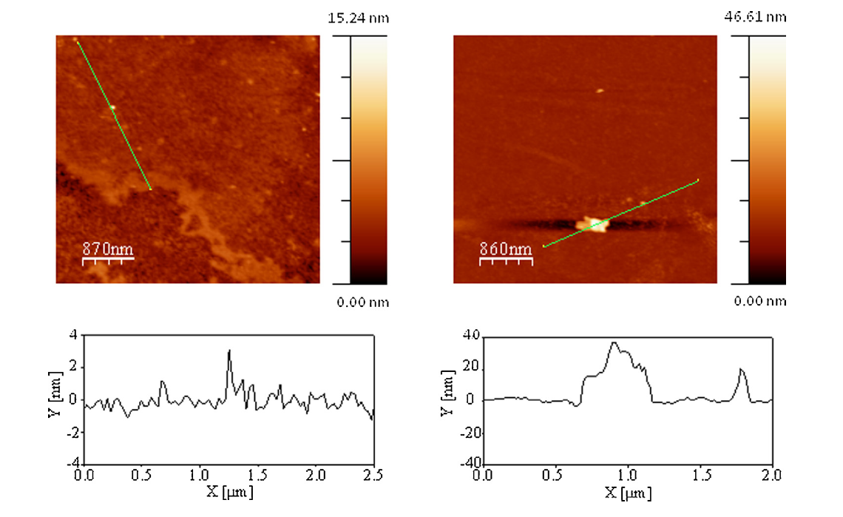
Few Selected Highlights of the Scientifi Work
Structures in mixed lipid-nanoparticle monolayer (CNR Genoa, Italy)
AFM images of LB films obtained at П = 35 mN/m from DPPC + DOPC + Cholesterol mono-layers spread at the water/vapour inter-face (left panel) and onto surface of a colloidal silica NP dispersion (right panel).
The presence of nanoparticles slows down the dynamic response of the monolayer to variations of the surface area.

Slide 4
Few Selected Highlights of the Scientifi Work
Influence of bubble surface fluidity on collision kinetics and attachment to hydrophobic solids (PAN Krakow, Poland)
microbubble
simulation
experiments
A comparison of the bubble shape variations during collision and attachment to hydrophobic surface in
distilled water, recorded in experiments and calculated numerically;
according to J. Zawala et al., Colloids Surfaces A, (2016); doi:10.1016/j.colsurfa.2015.12.023
A profound prolongation of time of the TPC formation was observed

Slide 5

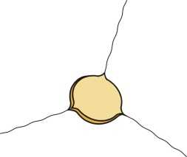










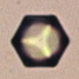
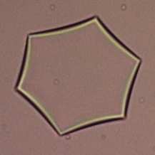
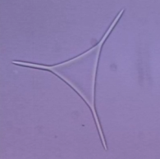
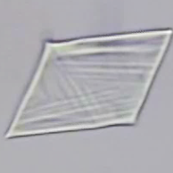
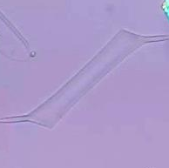
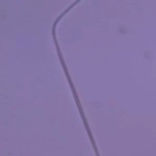
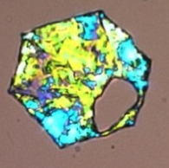
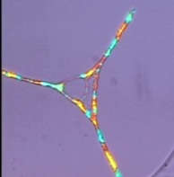
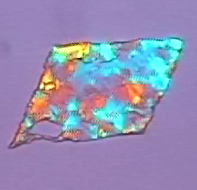
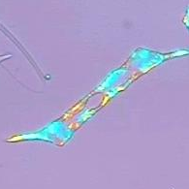
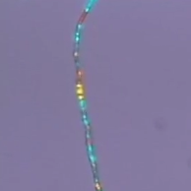
Few Selected Highlights of the Scientifi Work
Self-shaping of oil droplets upon cooling (Uni Sofia, Bulgaria)
a)
Slow cooling
or
b)
Moderate cooling
Timeline
c)
Liquid shaped droplets
or
d)
1:1
Solid particles
Aspect ratios:
1:3
1:10
1:4
1:10
>1:250
Schematic of the shape transformations observed during cooling emulsion droplets of pure hydrocarbons in water at different conditions
Complex regular shapes are obtained, including micrometre-sized octahedra, various polygonal platelets, O-shapes, and fibres.

Slide 6
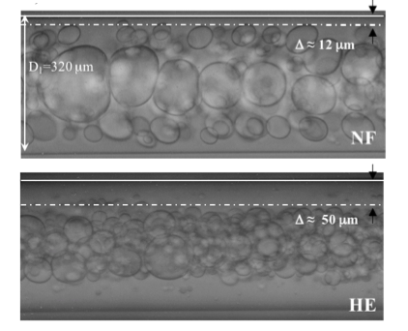
Few Selected Highlights of the Scientifi Work
Non-Newtonian Flow (University of Naples, Italy)
Wall depletion layer of Newtoninan (upper) and Elastic (lower) fluids as continuous phases, droplets are Newtonian Silicon Oils in both cases. The total flow rate is 30 ml/h, capillary internal diameter is 320 μm.
A droplet-free layer can be observed close to the wall, since larger droplets accumulate toward the channel axis.

