Slide 1
Final WG4 Report cost mp1106
Norman McMillan
Chair WG4 ‘Smart and Green Interface Instrumentation and Commercialisation

Slide 2
Schematic plan and implementation for S&G Instrumentation and Commercialisation
FP7
Survey of Members
2013
Analysis of their needs in S&G Instrumentation
HR2020
Report on Interests and Requirements of WG4 Membership
2013
Feedback from WG4 Members
Disaster SPECIAL FUNDS FOR JOINT COST PROJECTS DISPAPPEAR
Plans (i) Conference S&G Instrumentation (ii) Publication (iii) Commercialisation Support
Planned Autumn 2014
COST MP 1102, 1106 & 1302 Committed to Joint Nano COST Project with involvement of NANORA the FP7 Funded organisation for Nano-Commercialisation Support
LOST
2 Years
No Deliverable
1
2
3
Review Article from COST MP1106
Invention of MetaReview Process –Published in Refereed Library/Research Journal
Review Article on S&G Instrumentation and Commercialisation based on MetaReview Process

Slide 3
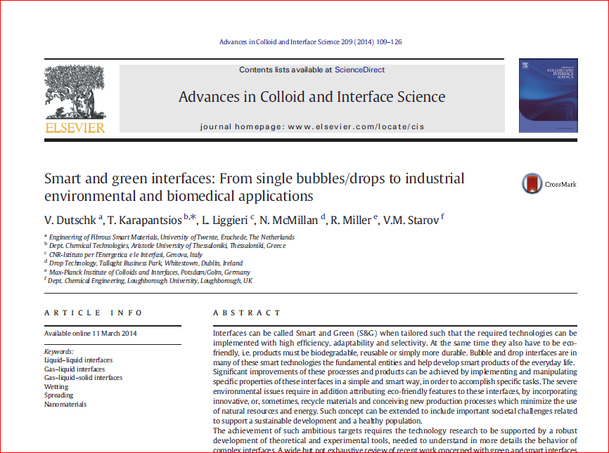
Review articles
COST MP1106 Review Article 2014
MetaReview Process Devised for ACIS Instrumentation Content
Library Journal Article to be Published
S&G Instrumentation and Commercialisation Review Article Published

Slide 4
Conclusions - deliverables
Kick-Off Meeting Organised in Trinity College Dublin 2013
Survey of WG4 Membership’s Needs
Review Article COST Workgroup Collaboration
MetaReview Process Developed for Objectifying Analysis of Topics/Course Design/Research Planning - Library Journal Article Written
Review Article to be written on ‘S&G Instrumentation and Commercialisation’
MOST IMPORTANT PROJECT (FULLY DEVELOPED EXCEPT VENUE NT FINALISED) ADDRESSING NEEDS OF WG4 MEMBERSHIP LOST THROUGH NO FAULT OF OURS

